Slide 1
Project Presentation Integrated Project
On
PROPREP
Nishtha, Pragti Gupta, Priya Gupta
2210991992, 2210992056, 2210992096
Supervised By
Dr. Kamal Saluja
Department of Computer Science and Engineering,
Chitkara University, Punjab

Slide 2
Content
Introduction
Problem Statement
Work Flow
Tech Stack
Features
Screenshots
Limitations
Conclusion
Future Scope

Slide 3
Introduction
ProPrep is an advanced AI-driven platform designed to help job seekers prepare effectively for both resume building and interview experiences. It offers a realistic, interactive mock interview environment and a smart resume builder, simulating real-world scenarios to boost users’ confidence and readiness. By leveraging cutting-edge AI technology, ProPrep generates personalized interview questions, analyzes responses, and provides constructive feedback—while also assisting in creating optimized, job-ready resumes tailored to industry standards.
ProPrep – Developed with Next.js, Drizzle ORM, Gemini AI, and Clerk, this module conducts AI-powered mock interviews, builds resume providing real-time feedback and personalized insights to enhance interview performance.
AI-Powered Interview Simulation – Generates tailored interview questions based on job roles, industries, and experience levels.
Real-Time Feedback & Analysis – Provides instant feedback on answers, highlighting strengths and areas for improvement.
AI Resume Builder – Offers a dynamic and responsive interface to create, edit, and optimize resumes. Includes content suggestions and alignment with job-specific keywords to increase visibility and impact.
ProPrep offers a complete solution for job aspirants, helping them ace their interviews with AI-driven guidance.

Slide 4
Problem Statement
Job seekers often face challenges in preparing effectively for interviews and building optimized resumes due to a lack of personalized, intelligent tools. Traditional mock interviews do not provide real-time feedback, adapt to different job roles, or assess soft skills such as confidence and communication. Likewise, manual resume creation often lacks structure, keyword optimization, and industry relevance. As a result, candidates struggle with structuring responses, improving delivery, and presenting professional resumes. ProPrep addresses these challenges through a unified AI-powered platform that offers realistic mock interview simulations and an intelligent resume builder, empowering users with instant feedback, tailored questions, resume guidance, and comprehensive preparation support.
Objective:
The objective of ProPrep is to provide an AI-driven interview preparation platform that helps candidates improve their communication skills, answer structuring, and overall interview performance.
Enhance Interview Readiness
Deliver Personalized Interview Practice
Offer a Seamless User Experience
Leverage Advanced Technologies
Empower Job Seekers

Slide 5
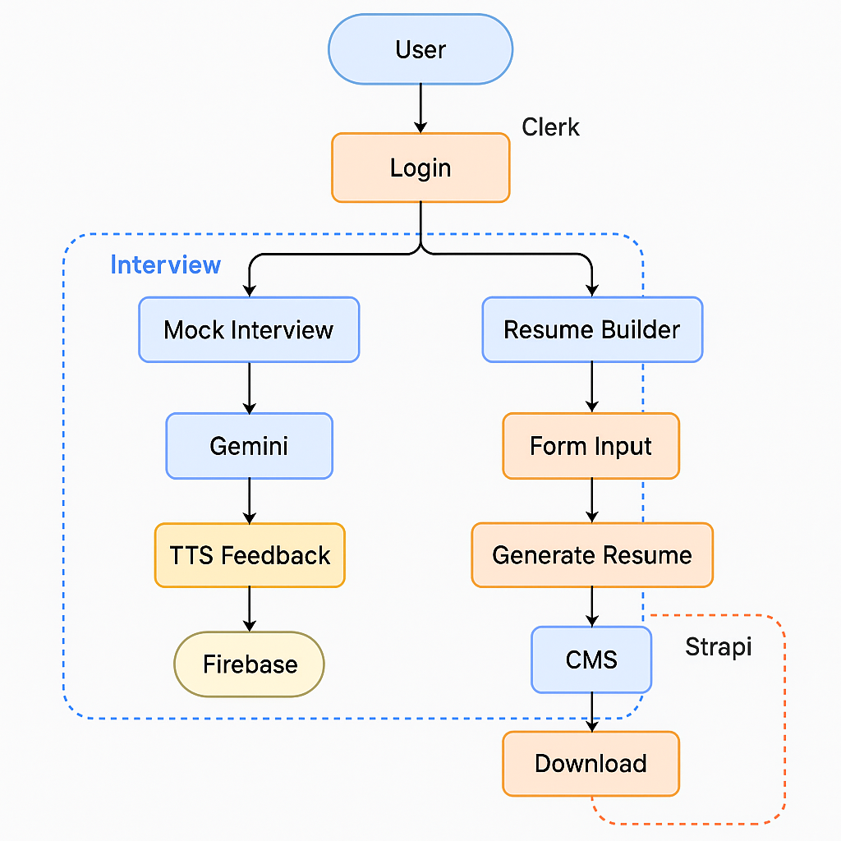
Work Flow

Slide 6
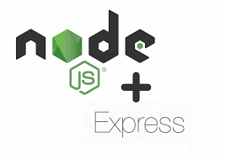

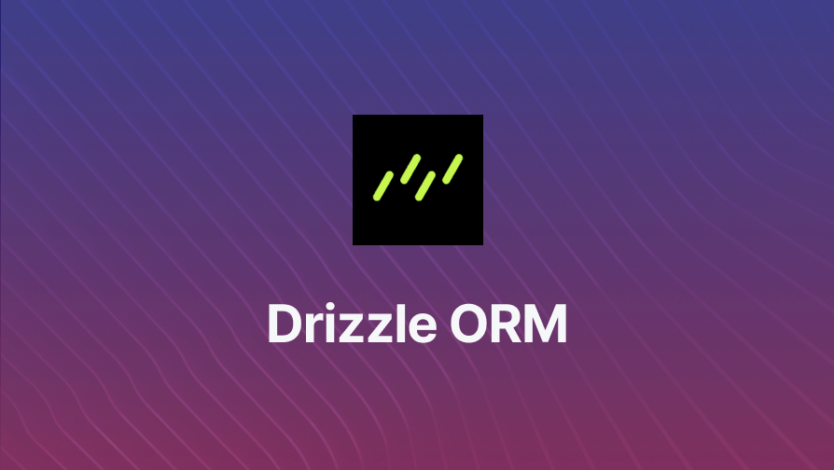

Tech Stack
The ProPrep platform is built using the MERN Stack along with additional technologies to enhance real-time communication and user experience.
Backend:
Frontend:
Database:

Slide 7
Features
Mock Interview Functionality (AI-Driven Feedback) :
Gemini AI for Adaptive Feedback: Leverage AI to provide personalized feedback based on interview responses.
WebSocket/Socket.io: For real-time interaction between users and the system during mock interviews.
Resume Builder Functionality (AI-Powered Suggestions)
Gemini AI for Smart Resume Suggestions: Integrated AI to generate context-relevant suggestions, keywords, and formatting tips to optimize resumes based on job roles and user input.
User Authentication & Management :
Clerk for Authentication: Secure user authentication and management using Clerk to handle sign-ups, logins and profiles.
Data Storage and Management :
Cloudinary or S3 for File Storage: For uploading, storing, and retrieving user-uploaded files(resumes, interview recordings).
Performance Analysis & Reporting :
AI-Generated Performance Reports: Provides detailed insights into strengths, weaknesses, and improvement areas after each mock interview.
Answer Improvement Suggestions: Offers AI-driven recommendations to refine answers and communication strategies.

Slide 8
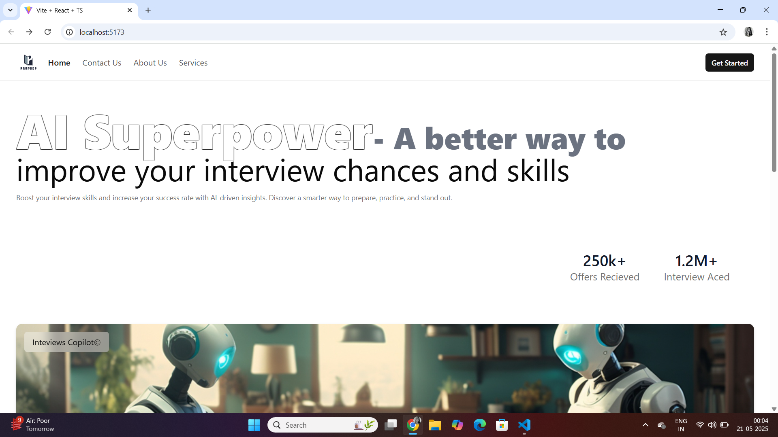
Screenshots

Slide 9
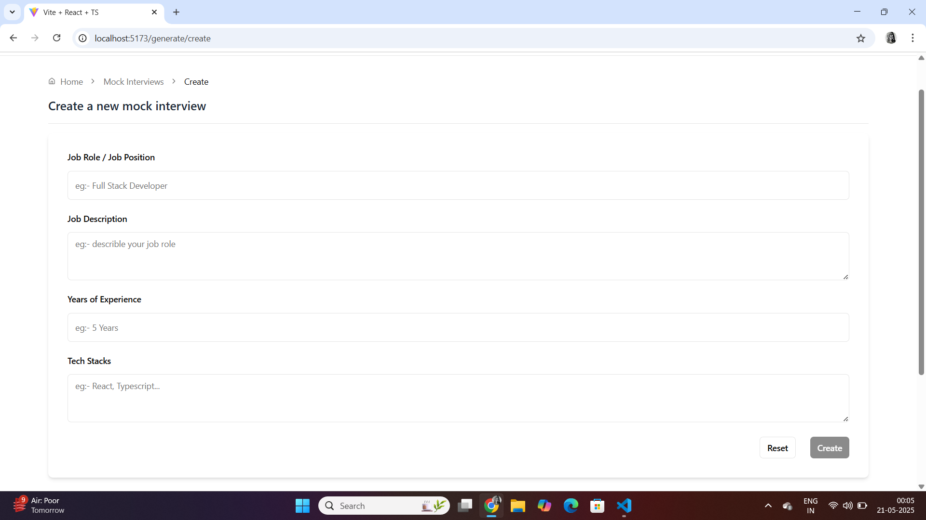
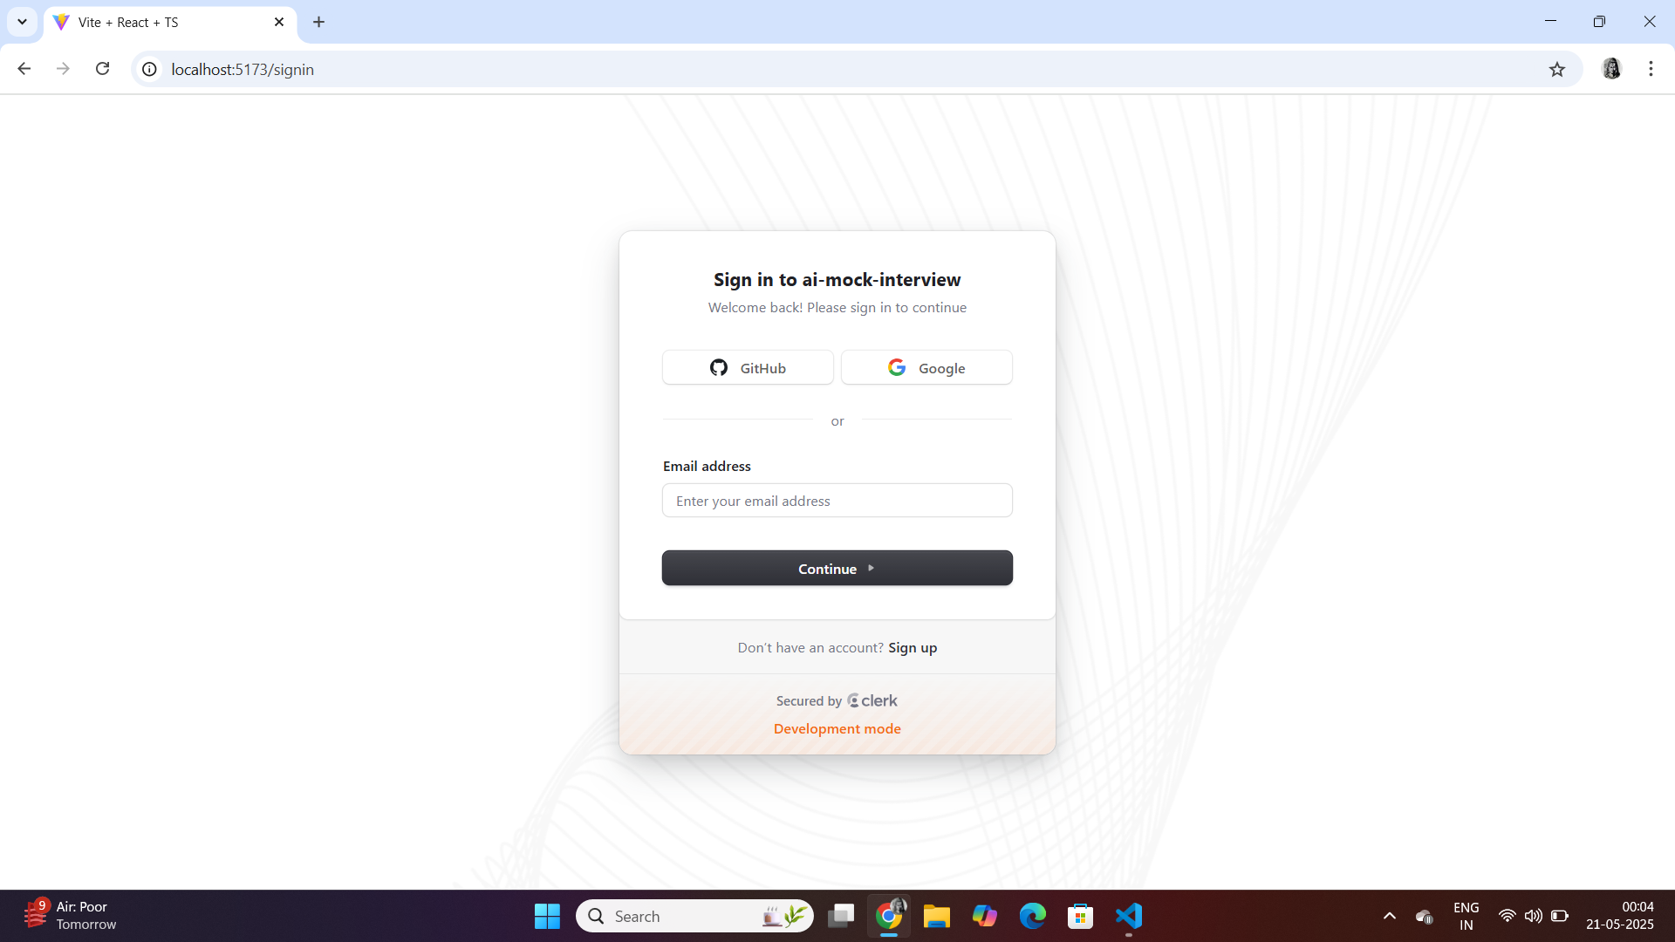
Screenshots

Slide 10
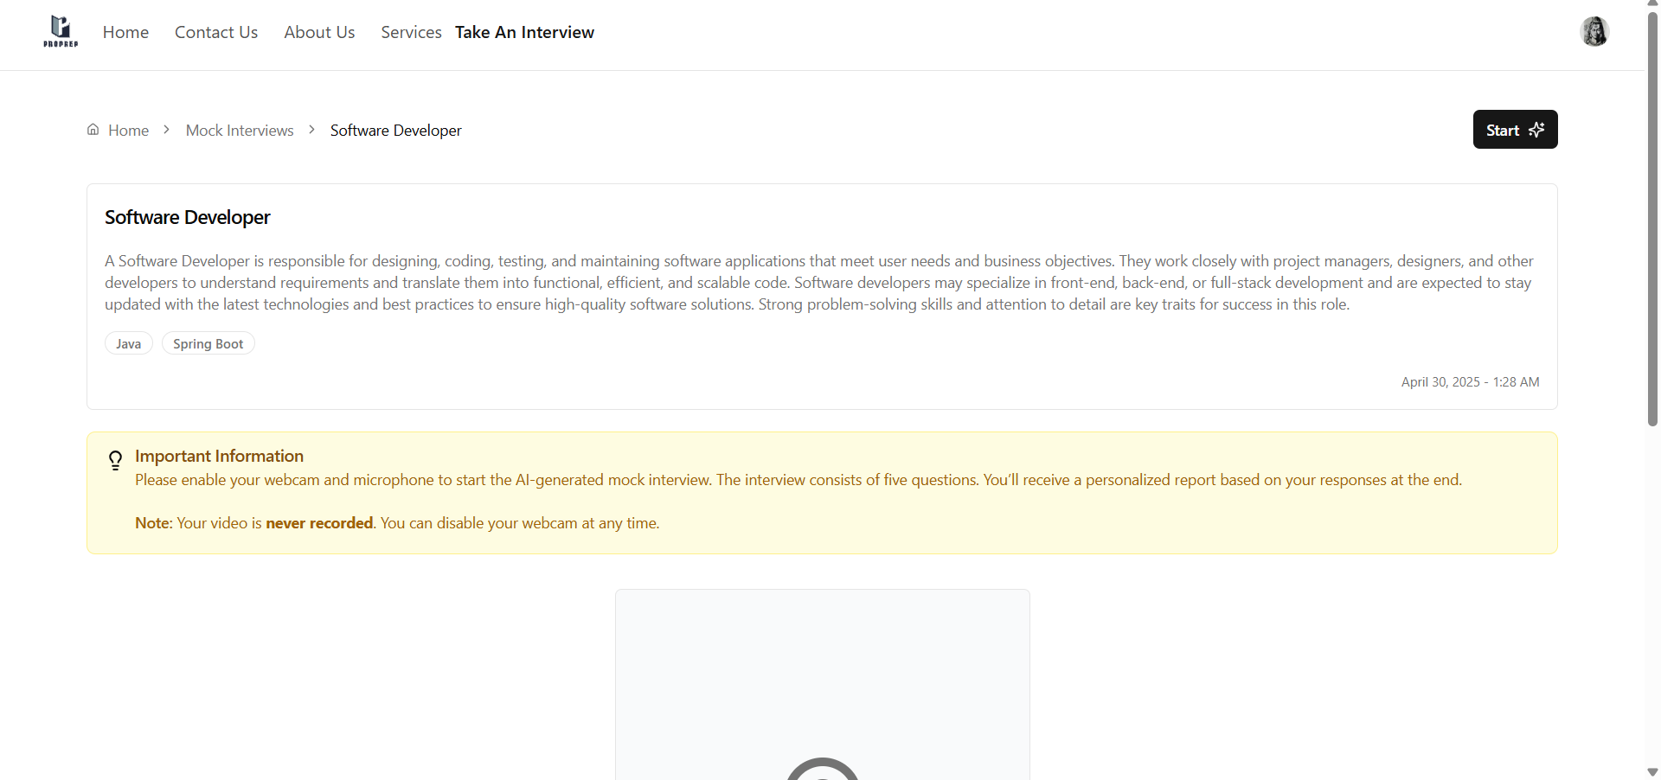
Screenshots

Slide 11
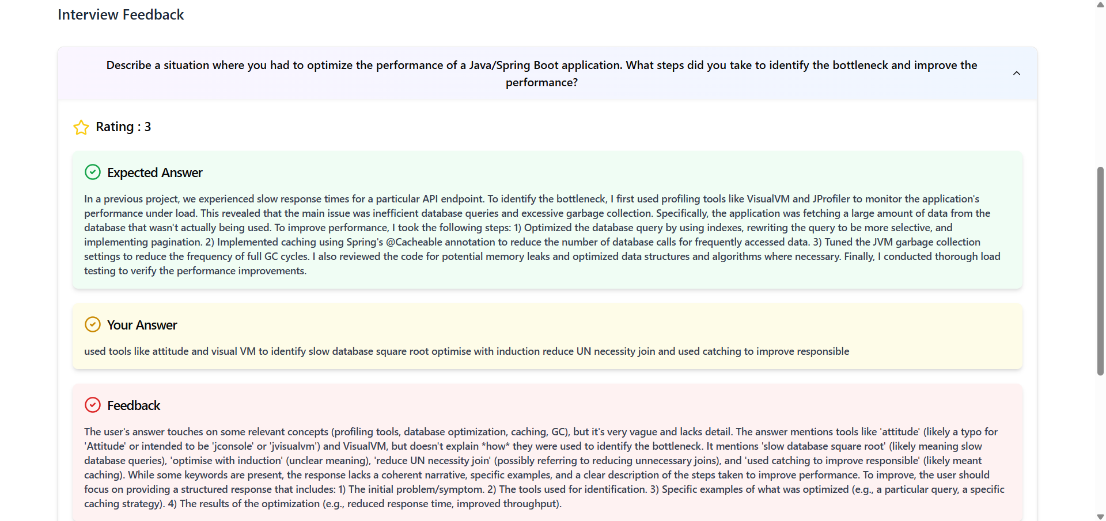
Screenshots

Slide 12
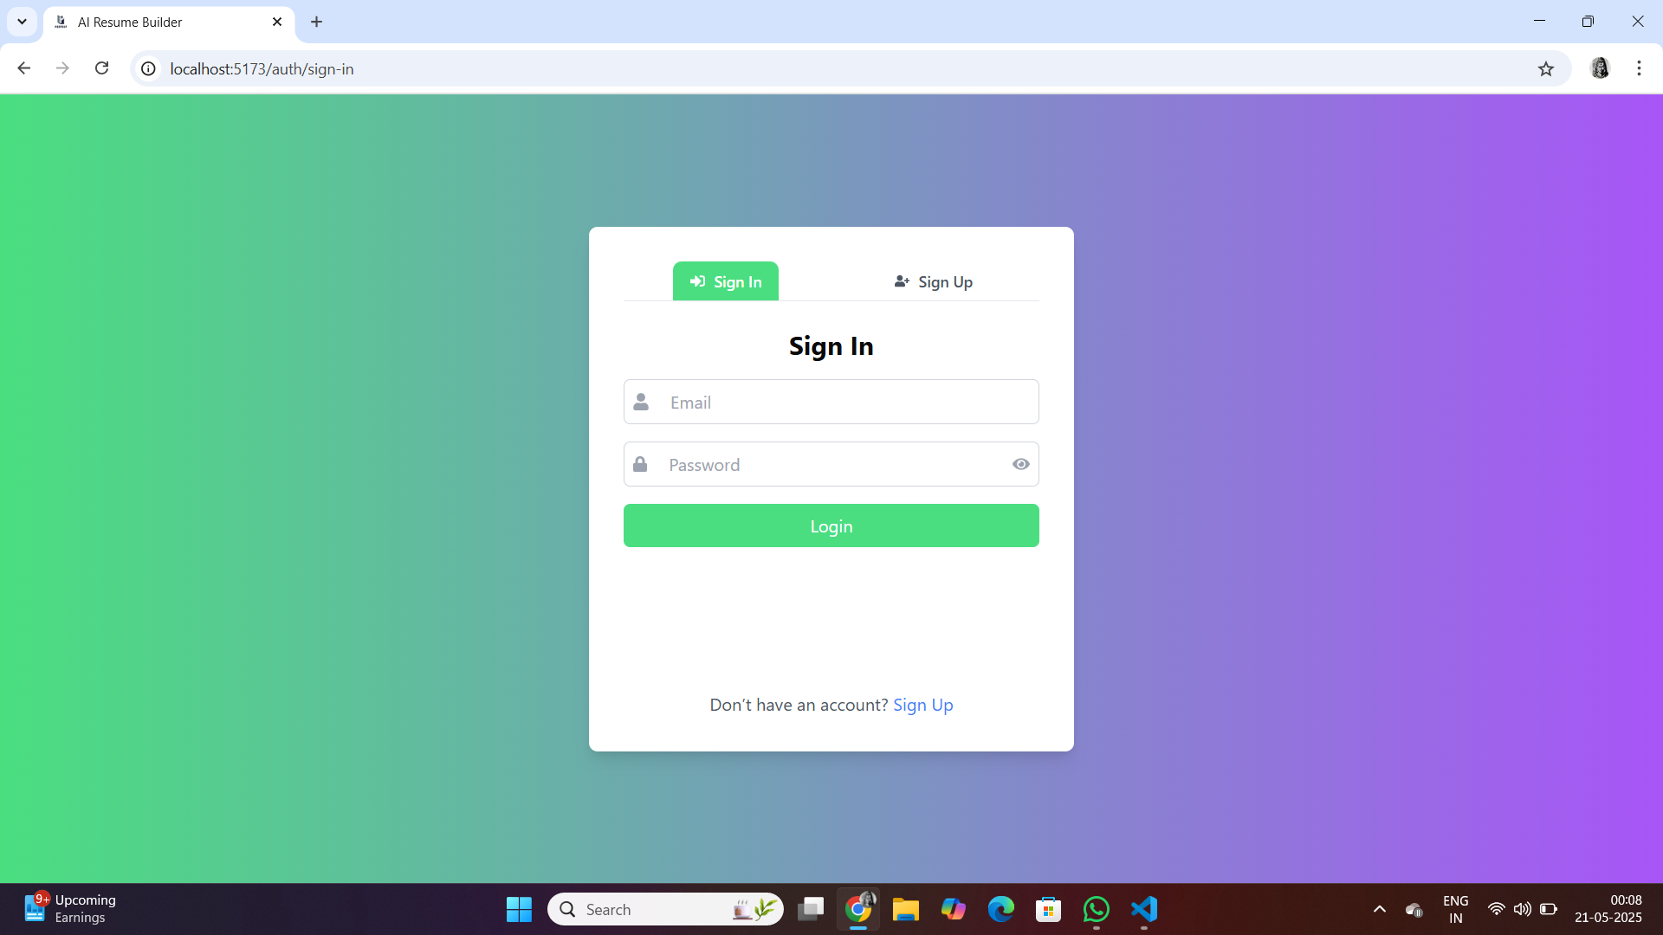
Screenshots

Slide 13
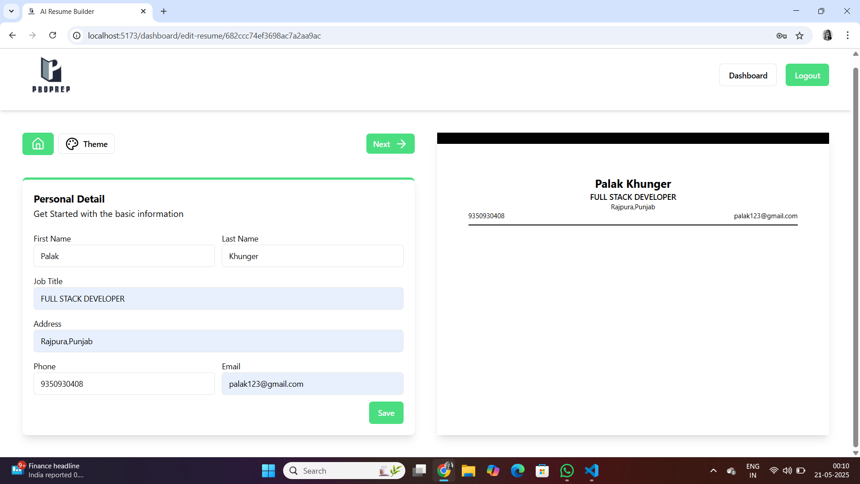
Screenshots

Slide 14
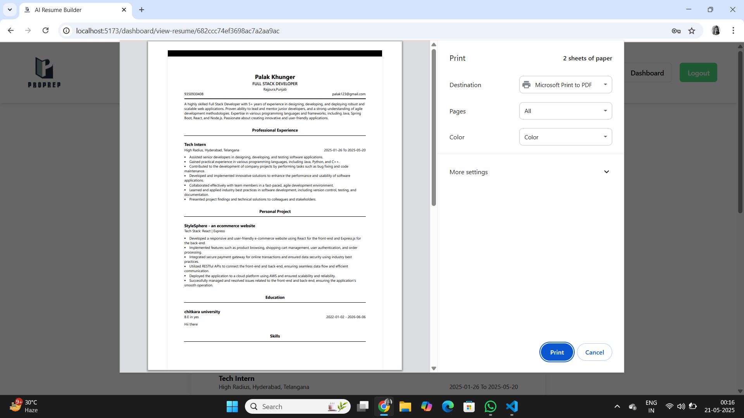
Screenshots

Slide 15
Limitations
AI Feedback Accuracy: May not always provide perfect insights, especially for industry-specific jargon or complex answers.
Speech Analysis Challenges: Accuracy can be affected by accents, background noise, and variations in speaking styles.
Third-Party Dependencies: Relies on Clerk (authentication), Cloudinary (file storage), and WebSocket/Socket.io (real-time interaction), which may face downtimes.
Limited Customization: AI-generated questions may not fully replicate human interview depth; manual customization options are limited.
Data Privacy & Security: Requires strong security measures for storing interview recordings and ensuring compliance with privacy regulations.
Resume Optimization Constraints: While the AI resume builder generates optimized suggestions, it may not always perfectly match specific job roles, especially for niche positions or unconventional career paths. More industry-specific resume customization features are expected in the future.

Slide 16
Conclusion
Key Takeaways
AI-Driven Mock Interviews – Provides personalized, real-time interview simulations tailored to job roles and industries.
Interactive & Scalable Platform – Built with Next.js, Drizzle ORM, Clerk, and Gemini AI for a seamless and efficient experience.
Real-Time Feedback & Insights –Leveraging AI, the platform provides instant feedback on responses, speech, and sentiment, giving users actionable insights to improve their communication, confidence, and interview performance.
Comprehensive Interview Preparation – ProPrep offers a complete solution for job seekers, enhancing their confidence, helping with answer structuring, and boosting overall interview readiness through personalized mock interviews and AI-driven resume optimization.
Future Vision
AI Avatars for Mock Interviews
Personalized Career Roadmap
Multi-Language Support
Community & Networking

Slide 17
Future Scope
AI-Powered Resume Optimization – Extend ProPrep’s capabilities to optimize resumes based on job descriptions and ATS compatibility.
Interview Success Prediction – Use AI analytics to predict users' chances of success based on their interview performance.
Community & Mentorship Program – Build a platform for users to connect with industry professionals for guidance and networking.
Integration with Job Portals – Connect with job platforms to provide users with relevant job recommendations based on their performance.
Video Recording & Playback – Allow users to record their mock interviews for self-assessment and improvement.

Slide 18

18

